Slide 1
Course Code: CSC211A Course Title: Formal Languages and Automata Theory
Lecture 27: Pumping Lemma for CFL-1
Course Leader:
Prakash P
prakashp.cs.et@msruas.ac.in

Slide 2
Session Objectives
At the end of this session, student will be able
Explain non-context free languages
Apply pumping lemma to prove that the given language is context free

Slide 3
Session Topics
Non-context free languages
Pumping lemma to prove that the given language is context free

Slide 4
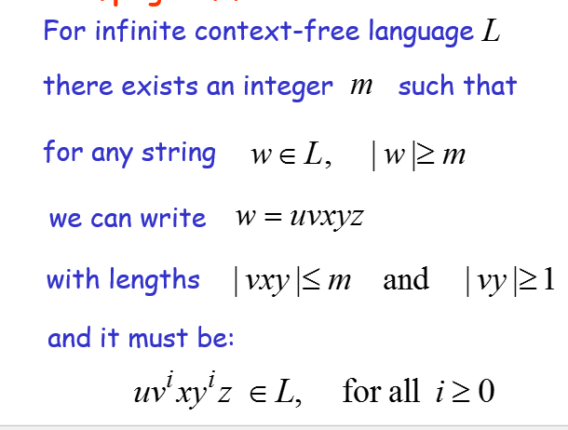
The Pumping Lemma

Slide 5
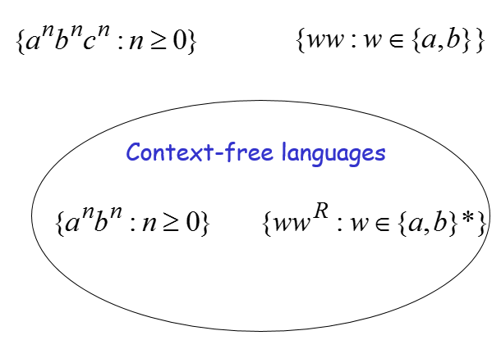
Non-Context Free Languages

Slide 6
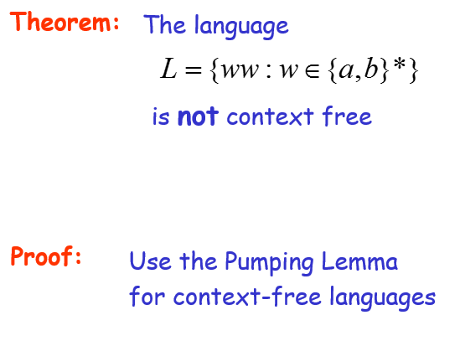
Non-Context Free Languages

Slide 7
Non-Context Free Languages
Assume for contradiction that
is context-free
Since is context-free and infinite we can apply the pumping lemma

Slide 8
Non-Context Free Languages
Pumping Lemma gives a magic number such that:
Pick any string of with length at least
we pick:

Slide 9
Non-Context Free Languages
We can write:
with lengths and
Pumping Lemma says:
for all

Slide 10
Pumping Lemma
We examine all the possible locations of string in

Slide 11
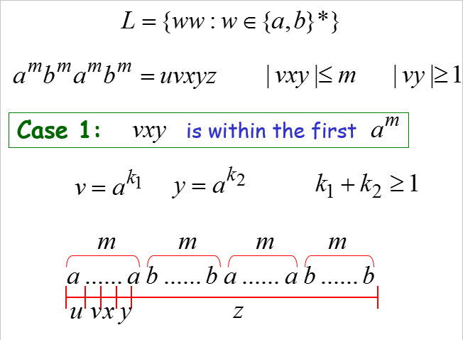
Pumping Lemma

Slide 12
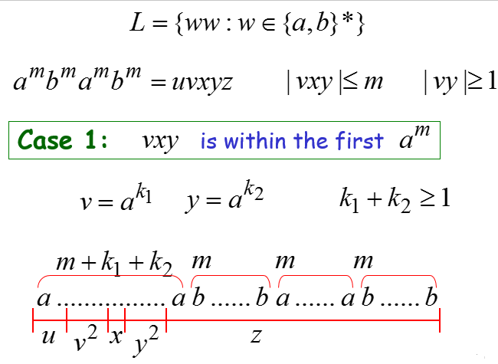
Pumping Lemma

Slide 13
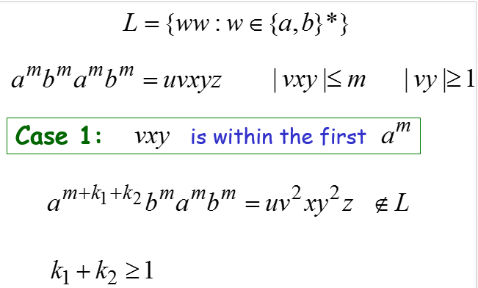
Pumping Lemma

Slide 14
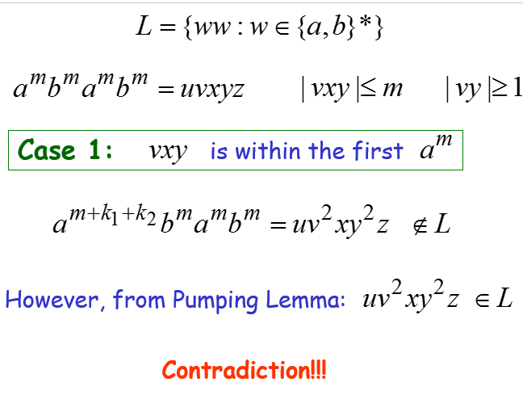
Pumping Lemma

Slide 15
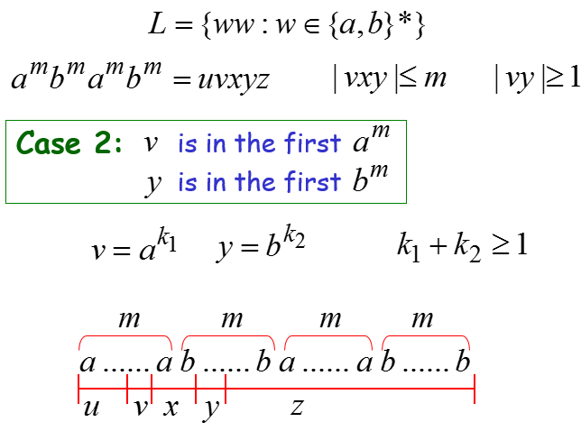
Pumping Lemma

Slide 16
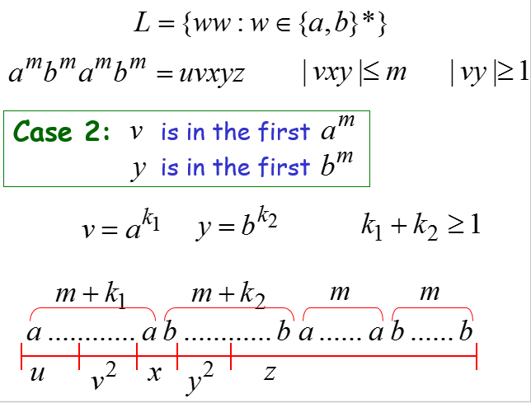
Pumping Lemma

Slide 17
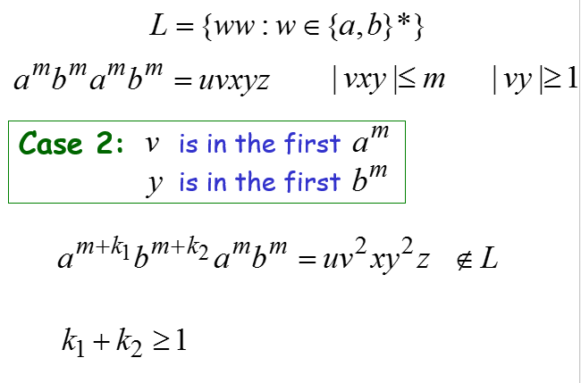
Pumping Lemma

Slide 18
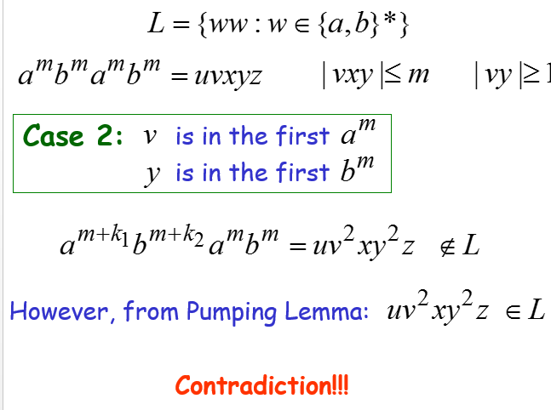
Pumping Lemma

Slide 19
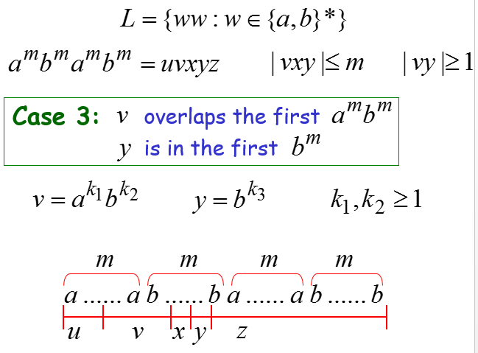
Pumping Lemma

Slide 20
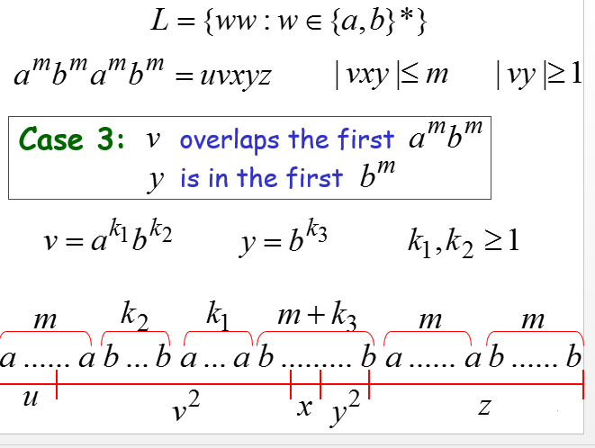
Pumping Lemma

Slide 21
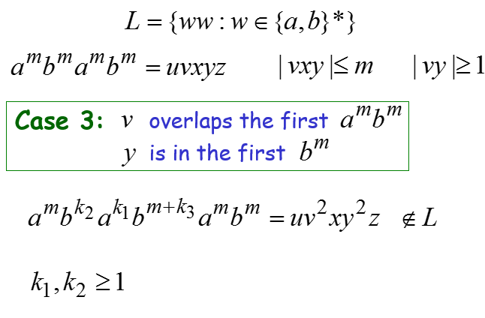
Pumping Lemma

Slide 22
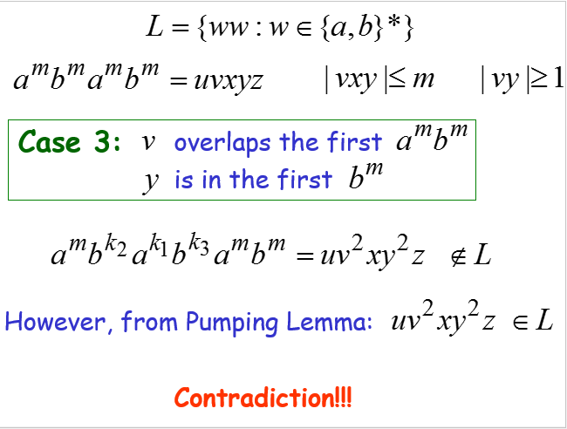
Pumping Lemma

Slide 23
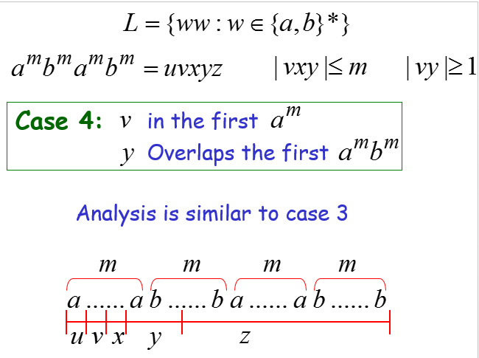
Pumping Lemma

Slide 24
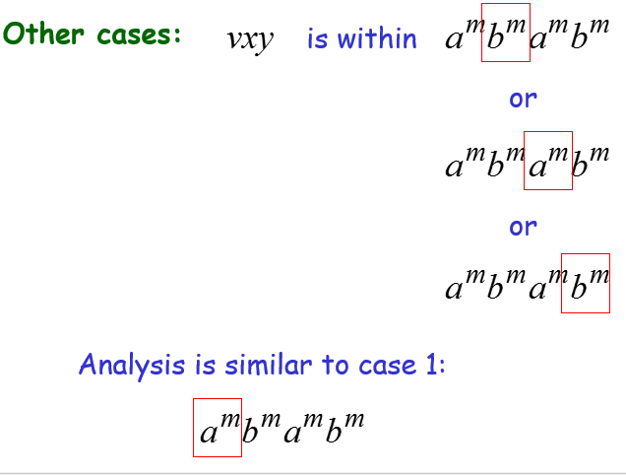
Pumping Lemma

Slide 25
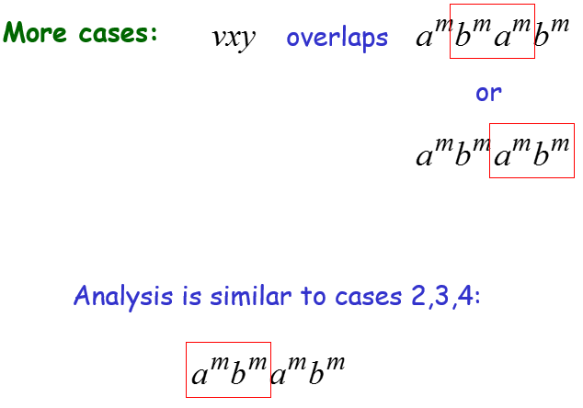
Pumping Lemma

Slide 26
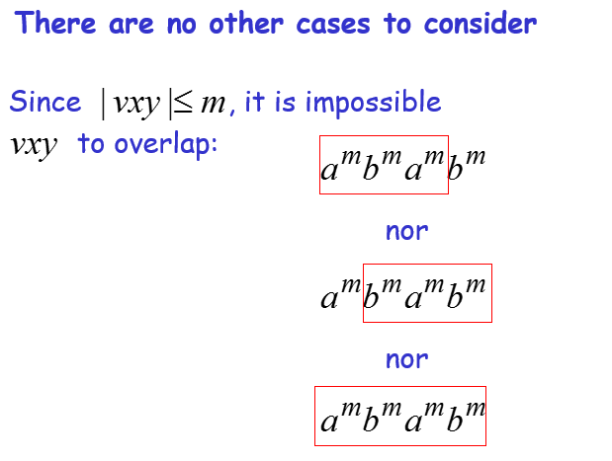
Pumping Lemma

Slide 27
Pumping Lemma
In all cases we obtained a contradiction
Therefore:
The original assumption that
is context-free must be wrong
Conclusion:
is not context-free

Slide 28
Summary
Pumping lemma is used to prove that the given language is context free

